Slide 1
UE21CS320A – Capstone Project Approval
Project Title : Generating Clear speech from Speech impaired Audio
Project ID : PW24_RS_03
Project Guide : Dr. Ramamoorthy Srinath
Project Team : Roseline Jerry A
T P Shriambhikesh
Tanmay Praveen Udupa
Vandana S

Slide 2
Outline
Introduction
Problem Statement
Scope
Feasibility study
Applications/Use cases
Expected Deliverables
Capstone (Phase-I & Phase-II) Project Timeline

Slide 3
Introduction
Speech disability accounted for 7.6% [1] of the total disabilities in India.
According to National Institute on Deafness and Communication (NIDCD), in 2016 approximately 7.5 million people have language impairments.[2]
There are more than 250,000,000 people with non standard speech needing accessible speech technologies. [3]
Models are usually trained on specific disorders, not generic.
[1] https://www.ncbi.nlm.nih.gov/pmc/articles/PMC6730860/ & https://informahealthcare.com/doi/abs/10.1080/13682820110116776
[2] https://www.ijert.org/research/diagnosis-of-disordered-speech-using-automatic-speech-recognition-IJERTCONV8IS11029.pdf
[3] https://sites.research.google/relate/

Slide 4
Problem Statement
The project addresses the challenge of impaired speech communication, where various speech impairments hinder clarity and understanding.
Individuals with speech difficulties, whether due to medical conditions or other factors, encounter barriers in effective communication.
The project emphasizes the need for a solution that enhances different types of impaired speech outputs, ensuring clearer and more understandable communication.

Slide 5
Scope
The project aims to develop an application to generate “normal” speech from speech with impairments.
Key components of the scope:
Develop and enhance a generic speech synthesis system for individuals with speech disorders.
Provide clear and natural-sounding speech output in the user's original voice.
Support real-time adaptation to changing speech patterns and contexts.
Facilitate user-friendly interactions and customization options.
Integrate feedback mechanisms to continuously improve the model's performance.
Ensure adherence to ethical standards, privacy, and security considerations.
Collaborate with speech therapists and healthcare professionals to align with therapeutic goals.
Notes:
The scope of the project would have the following components: we want to develop a generic speech synthesis system for individuals whose speech are generally not understood
We would look at individuals with speech disorders and we can expand the working to include accents, inebriation and so on
We want the speech output voice to match the speaker’s voice, and make it sound like natural speech output
We would use real time adaptation and add feedback loops to improve the model’s performance
Since this involves data from people with medical disorders we will make sure to comply to all the ethical standards and uphold the consent privacy and security of the individuals involved

Slide 6
Feasibility study
Data collection: Availability of a diverse dataset which includes conversations and their correct translation.
NLP Techniques: these techniques can be used to preprocess, analyse, extract features from the dataset which is to be used in the model.
Sentiment Analysis: Determining positive or negative response
Model Training: Training a model to accurately predict the destination user's response based on the source user's message is feasible using supervised learning techniques.
Number of Speakers Involved: Two/multiway impaired speech conversation

Slide 7
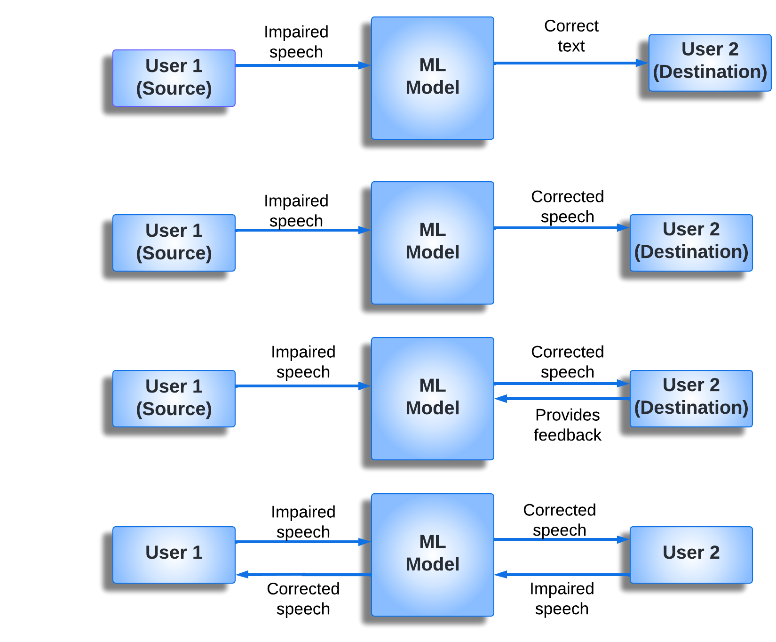
High level Scenario : 2 Speakers
Communication between 2 users where one has impaired speech and the speech is converted to text
Communication between 2 users, where one has impaired speech so its converted to corrected speech
Impaired speech converted to corrected speech after which the User receiving corrected speech provides Feedback
Communication between two impaired speakers

Slide 8
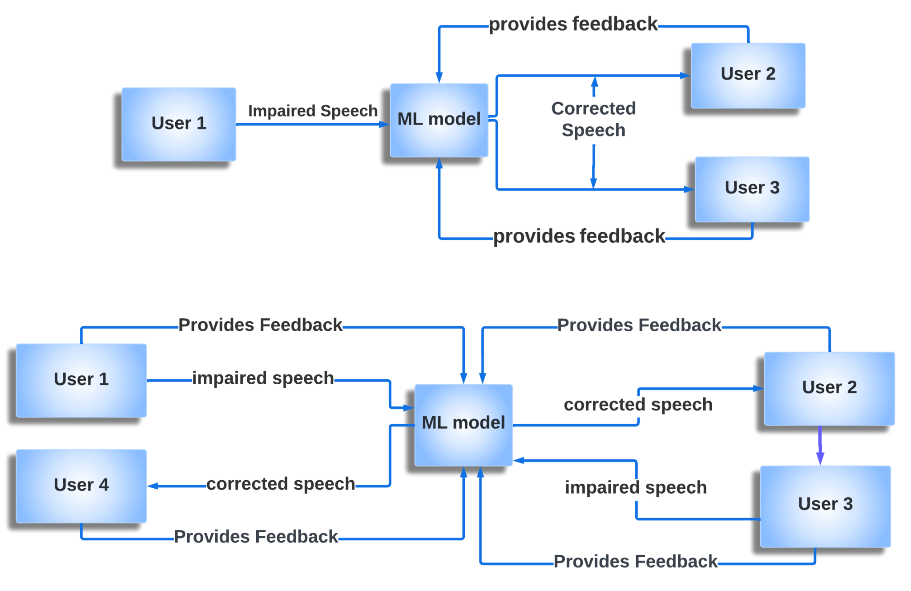
High level Scenario : Multiple-Speakers (Future Scope)
One impaired speaker communicating with 2 other normal speakers.
Multiple impaired speakers communicating with other speakers in a group setting.
Example: Group meeting , Job panel etc

Slide 9
Challenges
Data Limitations: Limited data can lead to underfitting or overfitting, which would affect the model’s accuracy.
Ethical Considerations: It should be ensured that privacy and consent in data collection is crucial. Ethical guidelines must be followed and the users must be informed about the purpose of their data.
Real world noise: Preprocessing techniques such as noise reduction, can be used to improve the model’s performance.
Subjective nature of clarity: Clarity of speech often varies on user’s perspective.

Slide 10
Applications/Use cases
Communication Aid: People with speech impairments like stammering or old people who have difficulty in articulating speech can use this application to communicate with other people more effectively.
Education: This application can be used to support students with speech impairments, so that they can participate actively in classroom discussions.
Employment Setting: Provides support to help the speech impaired candidates effectively convey their thoughts to the interviewer.
Courtrooms: People who are facing speech challenges can fully participate in legal proceedings.
Voice enabled technologies: This application makes it easier for speech impaired people to use the voice enabled feature in applications.

Slide 11
Dataset Survey
VCTK-Corpus | Kaggle Includes speech data uttered by 110 English speakers with various accents.
EasyCall Corpus
This dataset currently consists of 16683 audio recordings from 21 healthy and 26
dysarthric speakers.
Mobile Device Voice Recordings at King's College London (MDVR-KCL)
This dataset both contains recordings of both early and advanced Parkinson's disease patients and healthy controls.
LSVT Voice Rehabilitation
This dataset contains 126 samples from 14 subjects with Parkinson's Disease.

Slide 12
Expected Deliverables
Capstone-I deliverables
Project Plan
Project Literature Survey
Project Requirements Specification
High Level Design Document of the Project
Timeline and workflow outline
Speech Enhancement Algorithm
Cleaned and Pre-processed Dataset
Preliminary Proof-of-Concept

Slide 13
Expected Deliverables
Capstone-II deliverables
Low-level Design Document
Generative Model for Speech Enhancement
Multi-agent Speech Correction Model
Real-time Speech Processing Application
Application with a User-Friendly Interface

Slide 14
Capstone (Phase-I & Phase-II) Project Timeline
Stage | Activity | Est. Duration | Start date | End date | Deliverables
Research Design and Planning | Finalize research statement | 1 week | 05/01/2024 | 21/01/2024 | Research Proposal
 | Feasibility and requirement analysis | 1 week | 12/01/2024 | 19/01/2024 | Requirement Specification
Literature Review | Search and categorize relevant literature | 4 weeks | 05/01/2024 | 03/02/2024 | Reference list
 | Prepare draft literature review | 6 weeks | 05/02/2024 | 18/03/2024 | Literature review and analysis
Data Collection | Finalize sampling plan | 2 weeks | 12/02/2024 | 26/02/2024 | Data collection and sampling plan
 | Carry out data collection | 4 weeks | 01/03/2024 | 28/03/2024 | Raw data
 | Prepare dataset | 1 week | 29/03/2024 | 05/04/2024 | Draft dataset
Data Analysis | Clean and annotate data | 1 week | 06/04/2024 | 13/04/2024 | Preprocessed dataset
 | Analyze data behaviour | 1 week | 14/04/2024 | 21/04/2024 | Data analysis report
Speech Processing Model | Decide finer details of the neural network architecture | 2 weeks | 22/04/2024 | 05/05/2024 | Low level design document
 | Create prototype of the algorithm | 4 weeks | 25/06/2024 | 25/07/2024 | Proof of concept
 | Fine tune the model | 2 weeks | 26/07/2024 | 10/08/2024 | Generative speech enhancement model
 | Expand to include multiple scenarios | 4 weeks | 11/08/2024 | 11/09/2024 | Multiagent speech processing model
Paper writing | Draft the findings | 2 weeks | 12/09/2024 | 26/09/2024 | First draft
 | Seek feedback from Guide and iteratively improve | 1 week | 27/09/2024 | 10/10/2024 | Final draft
 | List conferences, journals and submission details | 1 week | 11/10/2024 | 20/10/2024 | Submission Plan

Slide 15
References
https://www.isca-archive.org/interspeech_2023/hermann23_interspeech.html
Parrotron: An End-to-End Speech-to-Speech Conversion Model and its Applications to Hearing-Impaired Speech and Speech Separation
Parrotron: New Research into Improving Verbal Communication for People with Speech Impairments
Personalized ASR Models from a Large and Diverse Disordered Speech Dataset – Google Research Blog
Detection of voice impairment for parkinson's disease using machine learning tools | IEEE Conference Publication
How Artificial Intelligence (AI) Can Help Children with Speech, Hearing, and Language Disorders: 40 Free Resources - Columbia Engineering Boot Camps
Machine learning assistive application for users with speech disorders - ScienceDirect
[1807.10948] Articulatory Features for ASR of Pathological Speech
Speech synthesis technologies for individuals with vocal disabilities: Voice banking and reconstruction

Slide 16
Thank You

